Slide 1


Slide 2
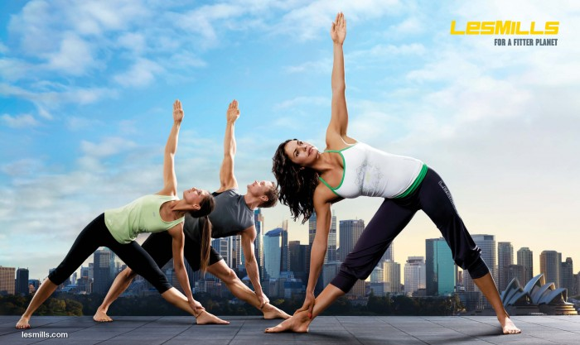

COURSES
Aerobics
& Yoga

Slide 3
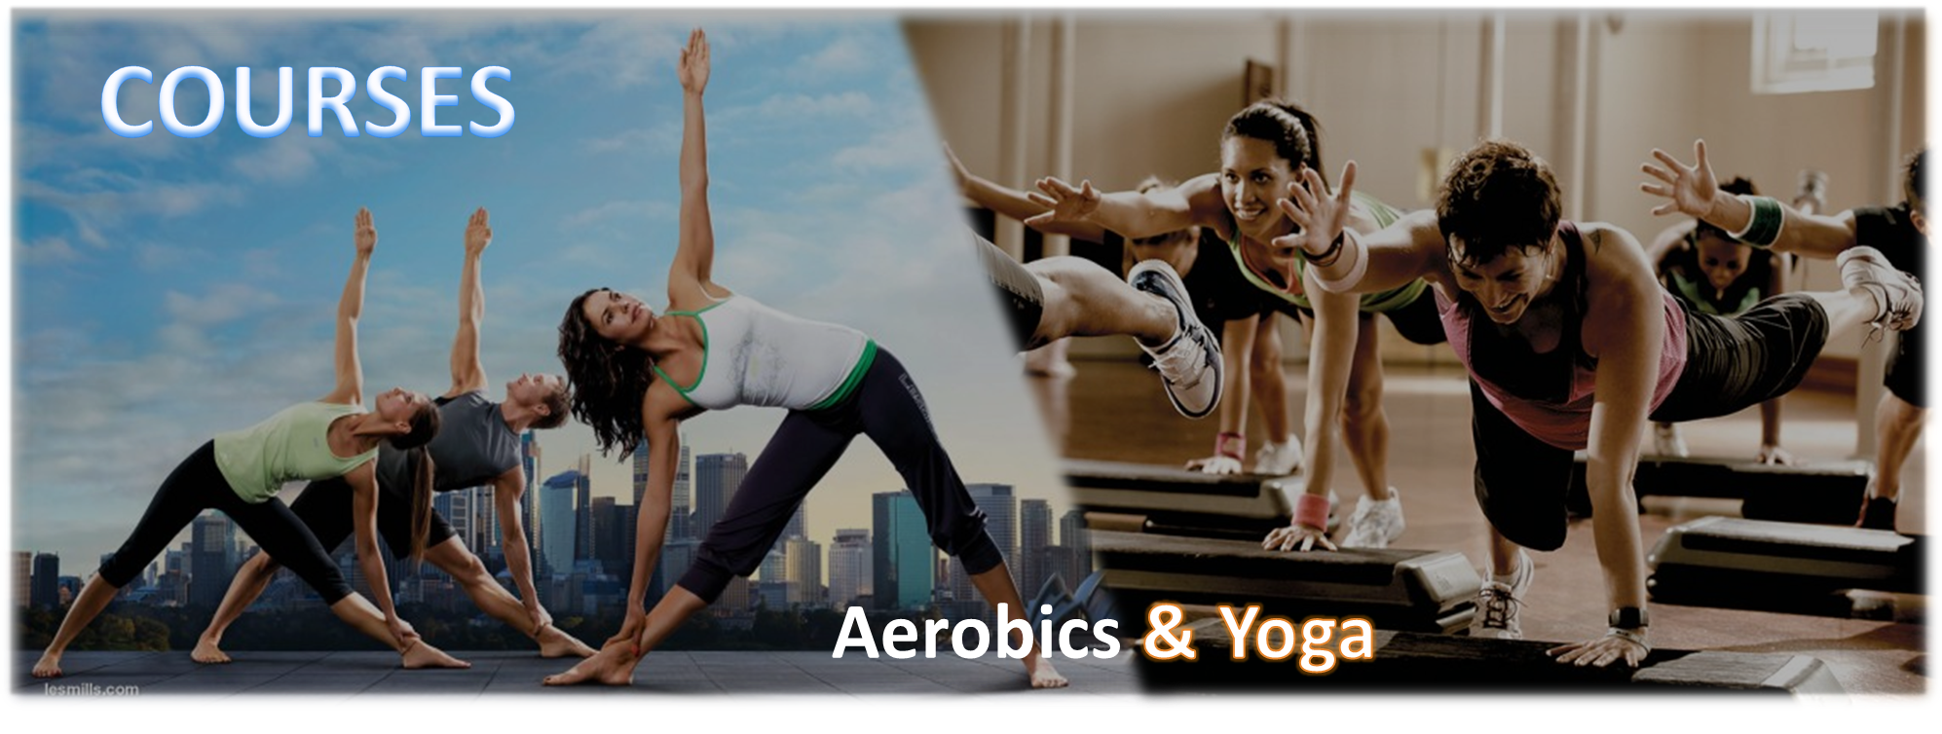

Slide 4

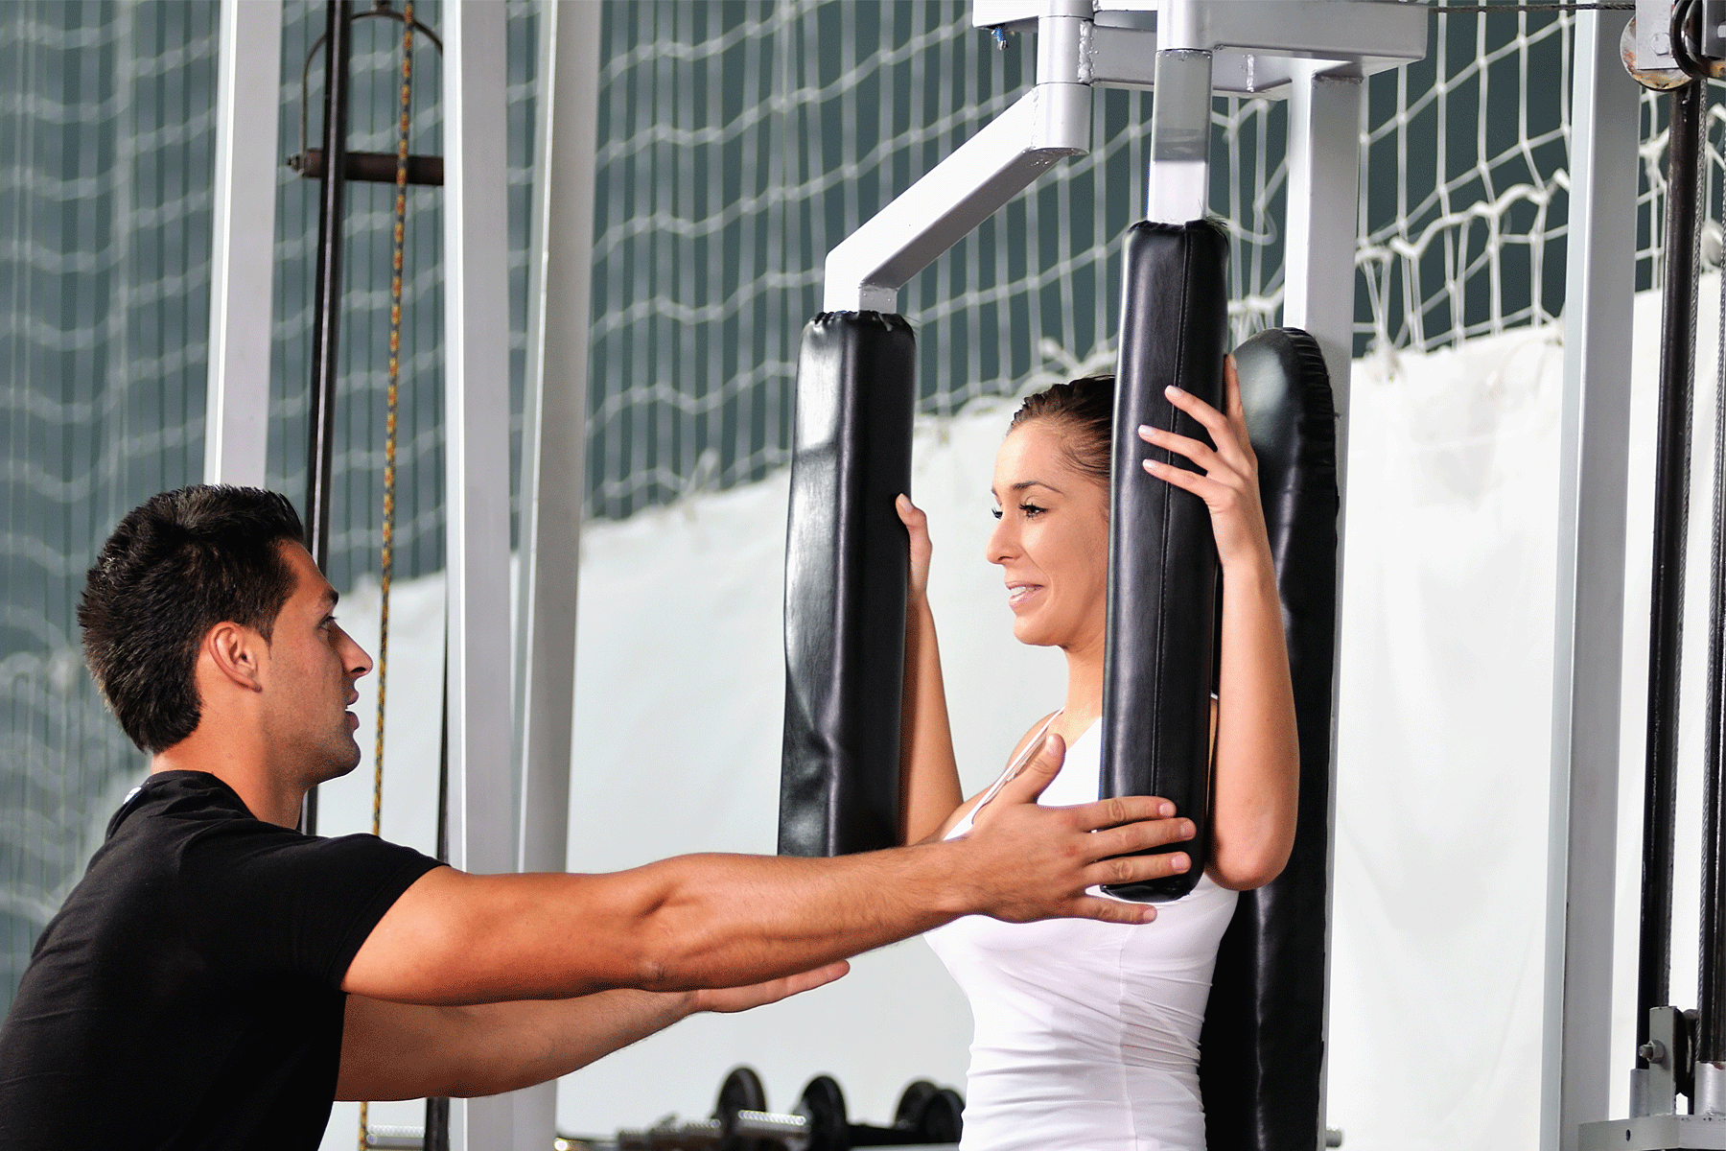

Slide 5



